Slide 1
ECE2810J Data Structures and Algorithms
Introduction

Slide 2
Outline
Course logistics
Introduction

Slide 3
Time and Location
Time:
Monday 12:10-1:50 pm, Wednesday 12:10-1:50 pm, Friday 12:10-1:50 pm (odd weeks)
An additional lecture at 2:00-3:40 pm on July 25th (Friday)
Location:
Monday lectures: DXY315 (Weeks 2-6); DSY115 (Weeks 7-12)
Wednesday lectures: DSY115 (Weeks 1-4); JI300 (Weeks 5-6); DSY115 (Weeks 7-12)
Friday lectures: DXY315 (Weeks 1, 3, 5); DSY115 (Weeks 7, 9, 11)
An additional lecture at 2:00-3:40 pm on July 25th (Friday): DSY115

Slide 4
Instructor
Weikang Qian
Email: qianwk@sjtu.edu.cn
Office: Room 430, Long Bin Building
Office hour
Monday and Wednesday 7:00 - 8:00 pm
Or by appointment

Slide 5

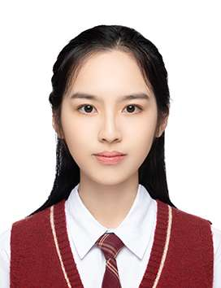
Teaching Assistant
CUI, Shuyuan (崔述源)
Email: qwerty123456@sjtu.edu.cn
GONG, Xinyan (龚欣妍)
Email: with-an-orchid@sjtu.edu.cn

Slide 6

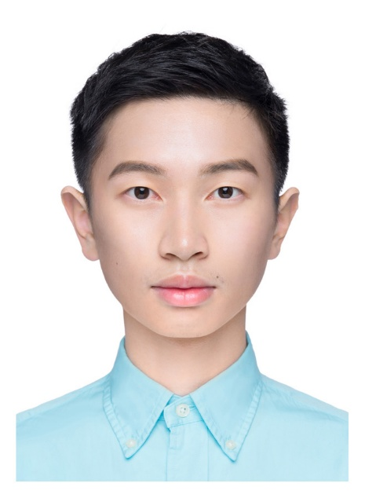
Teaching Assistant
JIANG, Nan (江楠)
Email: jiangnan7904@sjtu.edu.cn
ZHU, Kaiqi (朱恺麒)
Email: kevin7598@sjtu.edu.cn

Slide 7
Textbooks for Reference (Not Required)
“Data Structures and Algorithm Analysis,” by Clifford Shaffer. Online available: http://people.cs.vt.edu/~shaffer/Book/C++3e20120605.pdf
“Algorithms,” by S. Dasgupta, C. Papadimitriou, and U. Vazirani.
“Introduction to Algorithms, 3rd edition,” by Thomas Cormen et al., MIT Press, 2009.
“Data Structures and Algorithms with Object-Oriented Design Patterns in C++,” by Bruno Preiss.

Slide 8
Grading
Composition
Random pick & answer: default 2%
In-class quiz: default 3%
(About) 7 written assignments: 20%
(About) 5 programming assignments: 30%
Midterm exam (written): 20%
Final exam (written): 25%
We will curve the final grades, if necessary.
Questions about the grading?
Must be mentioned to the instructor or the TAs within one week after receiving the item.
Notes:
We will adjust the curve up or down if the class as a whole does better or worse than past instances. In particular, if everyone does exceptionally well, then everyone will get an exceptionally good grade.

Slide 9
Random Pick & Answer
I may ask a question from time to time and randomly pick a student to answer it
If you’re there every time when I ask you, you get all points (2%)
Otherwise, you’ll lose some points
It is possible that some “lucky” students may never be picked. In this case, their 2 points are added to quizzes.
I.e., for these students, their total quiz points is 5.

Slide 10
Programming Assignments
We require you to develop your programs using C++ on Linux operating systems with the compiler g++.
C++17 standard is allowed.
Compile with the option –std=c++17
We will grade your programs in the Linux environment: they must compile and run correctly on this operating system.
Do experiments on algorithms, e.g., sorting algorithm

Slide 11
Written Assignment Deadline
Each written assignment will be given a due date. Your work must be turned in by 11:59 pm on the due date to be accepted for full credit. Upload an e-version through the assignment link on Canvas.
No late submission allowed

Slide 12
Programming Assignment Deadline
Each programming assignment (PA) must be turned in by 11:59 pm on the due date to be accepted for full credit. Upload to JOJ (an online judge system)
However, we still allow you to submit your PA within 3 days after the due date, but there is a late penalty.
No PA will be accepted if it is more than 3 days late!
Hours Late | Scaling Factor
(0, 24] | 80 %
(24, 48] | 60 %
(48, 72] | 40 %

Slide 13
Assignment Deadline
In very occasional cases, we accept deadline extension request.
Contact me, not TAs!
ONLY be granted for documented medical/personal emergencies that could not have been anticipated.
NOT granted for reasons such as accidental erasure/loss of files and outside conflicting commitments.

Slide 14
Some Suggestions
Taking notes in class is a good idea.
Start doing the homework early!
Don’t wait until the last minute. Numerous lessons before
Back up your code frequently in case your computer crashes.
Consequence: “computer crash” is NOT a reason for late submission!

Slide 15
Exams
Written exams.
Some short questions
Some algorithm design problems
Closed book and closed notes.
No electronic devices are allowed.
These include laptops and cell phones.

Slide 16
Honor Code: Collaboration and Cheating
You may discuss in oral with your classmates.
But you must do all the assignments yourself.
Some behaviors that are considered as cheating:
Reading another student’s answer/code, including keeping a copy of another student’s answer/code.
Copying another student’s answer/code, in whole or in part.
Having someone else write part of your assignment.
Using test cases of another student.
Testing your code with another one’s account.
“Another student” includes a student in the current semester or in the previous semester.
Notes:
You are supposed to do it yourself. Why do you need a copy of another’s work?

Slide 17
Honor Code: Collaboration and Cheating
The previous lists of behaviors are deliberate cheating, but some unintentional actions could make you look like cheating. For example,
You use another’s computer to upload your code (in some cases like network/computer problems), but upload another’s copy.
You should be extremely careful!
If due to network/computer problem, you need to use another’s computer, double check the uploaded file.
Notes:
Yes, they do happen previously!

Slide 18
Honor Code: Collaboration and Cheating
In summary, you should be responsible for all answers/codes you submit. If you submit a copy of another student’s work (or overwrite another student’s work), it is considered cheating, no matter of the reason!

Slide 19
Honor Code: Teaching and Learning Materials
Teaching and learning materials, such as lecture slides, assignments, your solutions, quizzes, etc. are copyrighted and may not be passed on to others without the permission of the course instructor.
In particular, it is not permissible to post lecture slides, assignment questions, assignment solutions, etc., on public sites such as SlideShare
If you use Github to back up your code, make your repository private
You cannot use large language model (LLM)-based service, e.g., GPT.

Slide 20
Consequence of Honor Code Violation
Any suspect of honor code violation will be reported to the Honor Council at JI.
For programming assignments, we will run an automated test to check for unusually similar programs. Those that are highly similar - in whole or in part - will be reported to the Honor Council at JI.
Penalty of honor code violation
Reduction of the grade for this assignment to 0, plus
Reduction of the final grade for the course by one grade point, e.g., B+ → C+, for both students involved

Slide 21
Canvas
Log into Canvas: https://oc.sjtu.edu.cn/
Check the class webpage on the Canvas regularly for
Announcements
Slides
Assignments
Course slides will be uploaded onto Canvas before each lecture.

Slide 22
Getting Help
If you have any questions, you can come to see TAs and instructor during the office hour
Better choice for questions that are not easy to solve!
You can also post it on piazza
You can help answer your fellow students’ questions
For private question, you can also write emails to us

Slide 23

Aside: Fun Quizzes!
What?
Multiple-choice questions on slides with
Non-graded and Anonymous
Feel free to answer even if you’re not sure!
How?
Scan a QR code on your smartphone
Answer
Note: Some have a single answer; some can have more than one corrent answer
Why?
Have fun!
Allow you to check your understanding
Allow the instructor to adapt his teaching
Let’s try one!

Slide 24

Do You Know Data Structures?
Choose one answer:
A. I don’t know any data structures.
B. I only know some basic data structures like stacks and queues.
C. I know some advanced data structures such as hash tables and binary search trees, but have never used them.
D. I have used some advanced data structures before.

Slide 25
Prerequisite
Ve280 Programming and Elementary Data Structures
Compiling and debugging on Linux operating systems
C++ programming, including pointers, arrays, structs, etc.
Recursion
I/O streams, including file I/O
Classes
Dynamical memory management
Template
Linked list, stack, and queue

Slide 26
Prerequisite
Ve203 Discrete Mathematics
Computational complexity analysis
Some basic sorting algorithm, e.g., bubble sort, insertion sort, merge sort
Divide-and-conquer algorithm, master theorem
Graph, graph representation, depth first search, Dijkstra’s algorithm (shortest path)
Some important concepts will be reviewed

Slide 27
References and Copyright
Slides used (modified when necessary)
Sugih Jamin, University of Michigan
Sartaj Sahni, University of Florida
Bert Huang, Columbia University
Tim Roughgarden, Stanford University
Clifford Shaffer, Virginia Tech

Slide 28
Outline
Course logistics
Introduction

Slide 29
Data Structures and Algorithms
Data structure is a particular way of organizing data in a computer so that it can be used efficiently.
Example: linked list
We can store a set of records as a linked list
or as a tree (to be talked later).
first
Notes:
All programs manipulate data. So, all programs represent data in some way.
We may store record as an unsorted array / an array / linked list. But not only just store it, we want to do the operations efficiently.
The record stored by linked list is not efficient, for example

Slide 30
Logical versus Physical Form
A data structure have both a logical and a physical form.
Logical form: definition of the data structure at an abstraction level.
Physical form: implementation of the data structure.
Notes:
Next slide will show example

Slide 31
Data Structure Example: Linked List
class IntList {
node *first;
public:
...
};
Logical Form
first
Physical Form
struct node {
node *next;
int value;
};
next:
value:
next:
value:
next:
value:
4
2
3

Slide 32
Data Structures and Algorithms
Data manipulation requires an algorithm – a sequence of steps that solve a specific task.
Data structures + Algorithms = Programs
The study of data structures and algorithms is fundamental to Computer Science.
Database related to balanced binary search tree.
Computer networks related to shortest path algorithm.
...

Slide 33
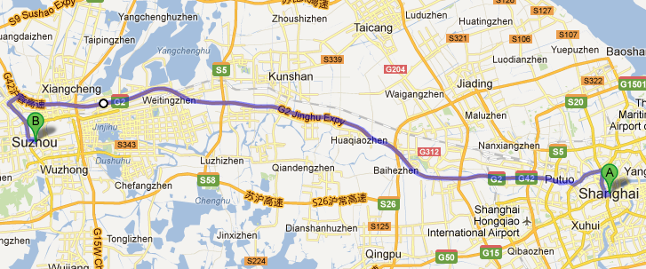
Real World Problem: Navigation
Finding the shortest route from Shanghai to Suzhou

Slide 34
Real World Problem: Navigation
What information do we need?
Streets.
Intersections of streets. (We assume that our departure place and destination are at certain intersections.)
How do we store the information in computer?
Graph: consisting of “nodes” and “edges”.
Each edge has a weight to denote the distance between two nodes.
5
3
2
1
Notes:
Streets as edges and intersections as nodes

Slide 35
Real World Problem: Navigation
The algorithm: finding the shortest path from a source node (A) to a sink node (B).
5
A
3
2
1
B

Slide 36
Challenges: Efficiency
For a small number of nodes, we can enumerate all the possible paths.
Path A → C → B: 8;
Path A → D → C → B: 6;
The minimum is 6.
5
A
C
3
2
1
D
B

Slide 37
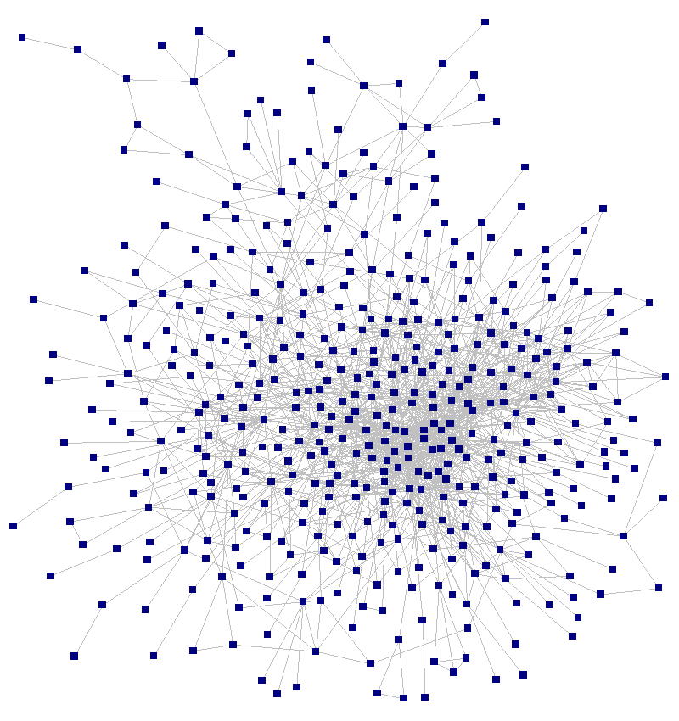
Challenges: Efficiency
However, in real world, the graph is much more complicated.
It is impossible to enumerate all the possible paths!
How can we solve the problem?
Dijkstra’s algorithm

Slide 38
More about Efficiency
Choice of data structures or algorithms can make the difference between a program running in a few seconds or many days.
Example: Number of comparisons for linear search and binary search (Worst Case)
Input Size | Linear | Binary | Ratio (L/B)
64 | 64 | 6 | 10.7
128 | 128 | 7 | 18.3
256 | 256 | 8 | 32
512 | 512 | 9 | 56.9
1024 | 1024 | 10 | 102.4

Slide 39
More about Efficiency
A solution is said to be efficient if it solves the problem within its resource constraints.
Space, i.e. memory consumption
Time
The cost of a solution is the amount of resources that the solution consumes.
We value efficiency of the data structures and algorithms!
We will learn how to analyze their efficiency.
✓
Our major concern

Slide 40
Course Objectives
Learn the tool:
Common data structures and algorithms
And their efficiency
Apply the tool
Solve a problem using existing data structures and algorithms.
Choose the right tool: some tools are better for certain tasks than other tools. Do performance analysis.

Slide 41
Topics
Asymptotic Algorithm Analysis
Data structures
Trees, including binary search tree, balanced binary search tree
Hash table
Heaps
Graphs
Algorithms
Sorting and searching
Graph-related algorithms, such as minimum spanning tree, topological sorting
Dynamic programming

Slide 42
Questions?

